Slide 1
Strategic Marketing
Global Marketing
Prof. Mohammed Rafiq
Professor of Marketing

Slide 2
The global marketplace
Topic outline
Discuss how the international trade system and economic, political-legal and cultural environments affect a company’s international marketing decisions.
Describe three key approaches to entering international markets.
Explain how companies adapt their marketing strategies and mixes for international markets

Slide 3
Global marketing today
A global firm
Operates in more than one country.
Gains marketing, production, R&D and financial advantages not available to purely domestic competitors.
Sees the world as one market.

Slide 4
Global Marketing Today
Copyright © 2016 Pearson Education, Inc.
19-7

Slide 5
The marketing task in the domestic environment
Social/ Cultural Environment
PRODUCT
PRICE
Economic Environment
Competition
PROMOTION
PLACE
Political/ Legal Environment

Slide 6
Going international
Internationalization
Saturated domestic markets
Small domestic markets
Low growth domestic markets
Customer drivers
Competitive forces
Cost factors
Portfolio balance
Notes:
2

Slide 7
Environmental Forces in International Markets
Cultural, Social, and Ethical Forces
Beliefs and values about:
Family
Religion
Education
Health
Recreation

Slide 8
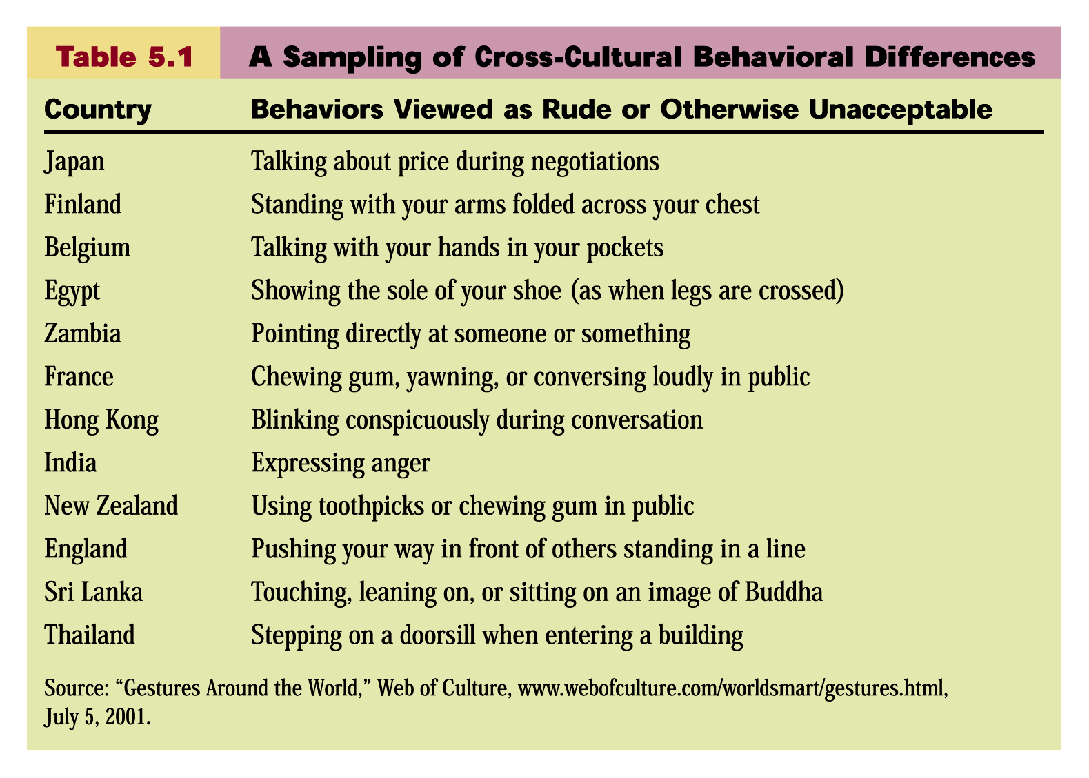

Slide 9
Environmental Forces in International Markets (cont’d)
Economic Differences Affecting International Marketing
Standards of living
Credit
Buying power
Income distribution
National resources
Exchange rates

Slide 10
Environmental Forces in International Markets (cont’d)
Trade Restrictions Affecting International Marketing
Import tariff
A duty levied by a nation on goods bought outside its borders and brought in
Quota
A limit on the amount of goods an importing country will accept for certain product categories in a specific period of time
Border

Slide 11

Looking at the Global Marketing Environment
The International Trade System
Certain countries have formed free trade zones or economic communities.
European Union (EU)
North American Free Trade Agreement (NAFTA)
Central American Free Trade Association (CAFTA)
Union of South American Nations (UNASUR
Copyright © 2016 Pearson Education, Inc.
19-13

Slide 12
Looking at the global marketing environment (Continued)
The international trade system
Exchange controls are a limit on the amount of foreign exchange and the exchange rate against other currencies.
Non-tariff trade barriers are biases against bids or restrictive product standards that go against foreign companies.

Slide 13
Environmental Forces in International Markets (cont’d)
Political and Legal Forces
Governmental policies, laws, and regulations
Import barriers (quotas, port-of-entry taxes)
Standards of ethics (payoffs, bribes)
Technological Forces
Telecommunications (e-mail, cell phones, Internet)
Extent of technological infrastructure

Slide 14
Selecting foreign markets
Macroenvironmental issues
Economic
Socio-cultural
Political-legal
Foreign market selection
Microenvironmental issues
Market attractiveness
Company capability profile
Notes:
3

Slide 15
Selecting foreign markets
Macroenvironmental issues
Economic
Socio-cultural
Political-legal
Microenvironmental issues
Market attractiveness
Company capability profile
market size and growth rate
competition
costs of serving the market
profit potential
market access
skills
resources
product adaptation
competitive advantage
Notes:
4

Slide 16

Foreign market entry strategies
Foreign market entry
Exporting
Joint ventures
Direct investment
Indirect
Direct
Licensing
Joint ventures
New facilities
Acquisitions
Notes:
5

Slide 17
Foreign market entry strategies
Foreign market entry
Exporting
Cooperative
Direct investment
Exporting
Indirect
Direct
domestic-based export merchants
domestic-based export agents
piggybacking
cooperative organizations
foreign-based agents or distributors
domestic-based sales representatives
overseas sales/marketing office or subsidiary
Notes:
6

Slide 18
Deciding How to Enter the Market
Joint Venturing
Licensing is when a firm enters into an agreement with a licensee in a foreign market. For a fee or royalty, the licensee buys the right to use the company’s process, trademark, patent, trade secret, or other item of value.
Copyright © 2016 Pearson Education, Inc.
19-27

Slide 19
Deciding How to Enter the Market
Joint Venturing
Joint ownership is when one company joins forces with foreign investors to create a local business in which they share joint ownership and control. Joint ownership is sometimes required for economic or political reasons.
Copyright © 2016 Pearson Education, Inc.
19-30

Slide 20
Deciding How to Enter the Market
Direct Investment
Direct investment is the development of foreign-based assembly or manufacturing facilities. It offers a number of advantages including:
Labor
Logistics
Control
Government incentives
Lower costs
Raw materials
Copyright © 2016 Pearson Education, Inc.
19-31

Slide 21

Approaches to developing international marketing strategies
Undifferentiated market
Product
Promotion
Undifferentiated
Price
Place
Notes:
7

Slide 22
Approaches to developing international marketing strategies
Market segmentation
Product 1
Promotion 1
Price 1
Place
1
Target 1
Product 2
Promotion 2
Target 2
Price 2
Place
2
Target 3
Product 3
Promotion 3
Price 3
Place
3
Notes:
8

Slide 23
Approaches to developing international marketing strategies
Market segmentation
Product 1
Promotion 1
Based on:
Price 1
Place
1
Buyer motivations
Buyer preferences
Buyer behaviour
Buyer price sensitivities
Product 2
Promotion 2
Profiled on:
Price 2
Place
2
Region
Lifestyle
Income
Age
etc.
Product 3
Promotion 3
Price 3
Place
3
Notes:
9

Slide 24
Customization Versus Globalization of International Marketing Strategies
Adaptation/ Customization
Adjusting marketing mixes according to cultural, regional, and national differences
Standardisation/ Globalization
The development of marketing strategies that treat the entire world (or its major regions) as a single entity
Includes standardization of products, promotion campaigns, prices, and distribution channels
“Think globally, act locally”

Slide 25
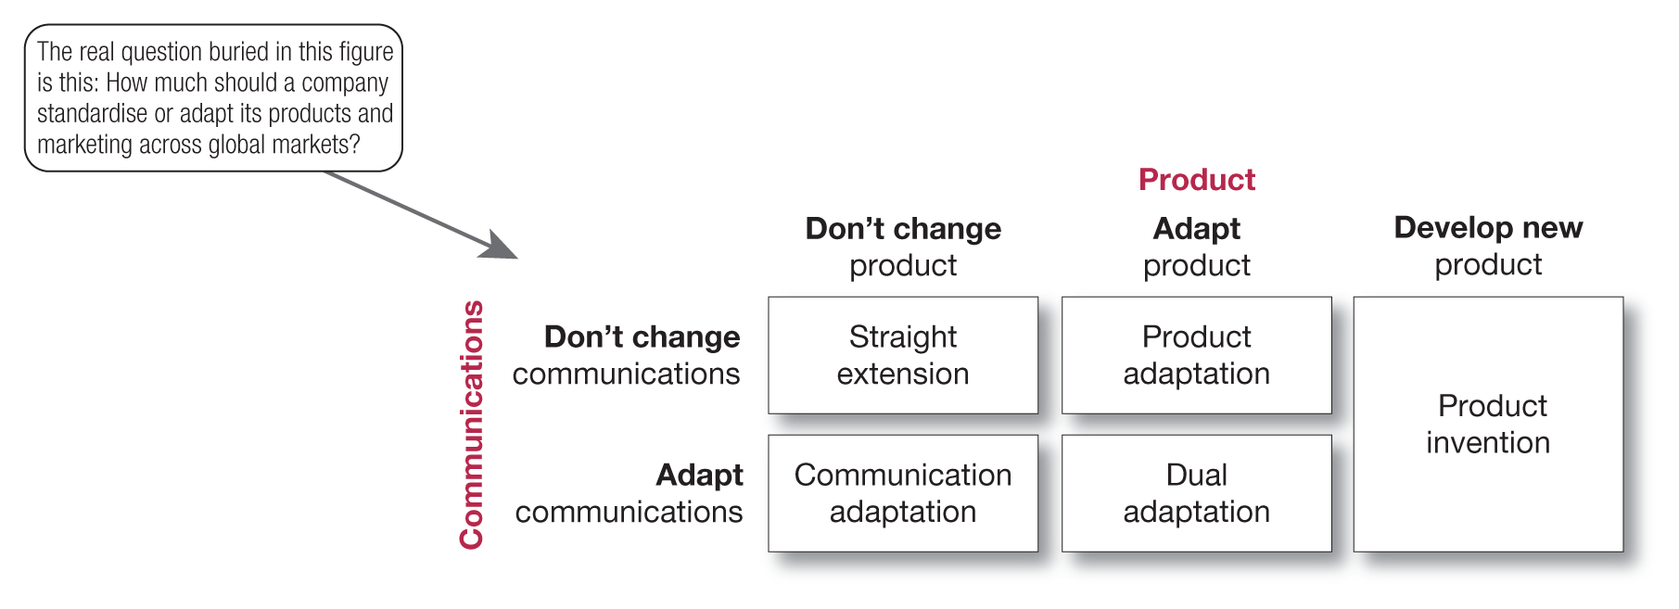
Deciding on the global marketing program (Continued)
Product

Slide 26
Deciding on the Global Marketing Program
Promotion
Companies can either adopt the same communication strategy they use at home or change it for each market.
Even in standardized communications campaigns, adjustments may be required for language or cultural differences.
Copyright © 2016 Pearson Education, Inc.
19-36

Slide 27
Deciding on the Global Marketing Program
Price
Uniform pricing charges the same price in all markets but does not consider income or wealth where the price may be too high in some or not high enough in other markets.
Standard markup pricing is a price based on a percentage of cost but can cause problems in countries with high costs.
Copyright © 2016 Pearson Education, Inc.
19-37

Slide 28
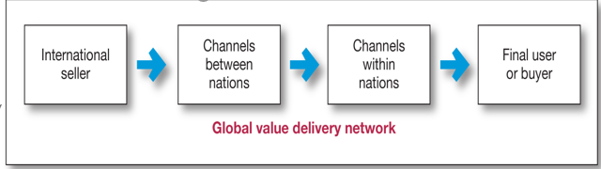
Whole-channel concept for international marketing

Slide 29
Deciding on the global marketing organisation
Typical management of international marketing activities include:
Establishing an exporting department with a sales manager and staff.
Creating an international division organised by geography, products or operating units.
Becoming a complete global organisation.

